Slide 1
History of Computer Art
URL: http://iasl.uni-muenchen.de/links/GCA_Indexe.html
  Part VII: Evolutionary Art
  Seminar, 28nd April 2014
  Danube University Krems
  Department for Arts and Image Science
  MediaArtHistories: Masters of Art
Thomas Dreher
URL: http://dreher.netzliteratur.net

Slide 2
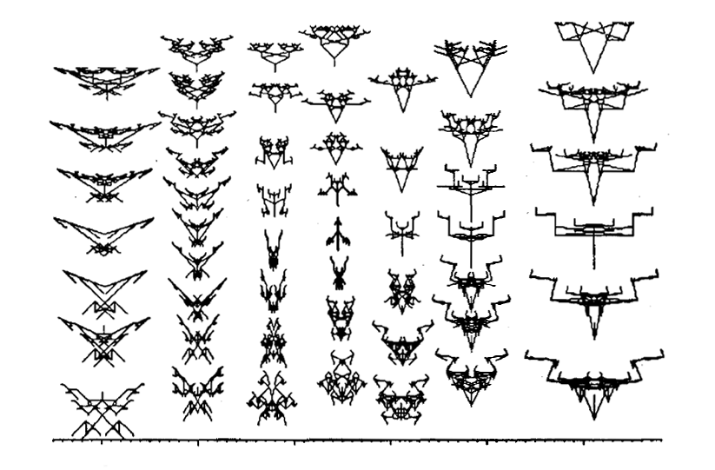
Biomorphs
Dawkins, Richard: The Blind Watchmaker, 1986, examples of a model for the "evolution game" (Dawkins: Watchmaker 1986, p.70, fig.8).

Slide 3
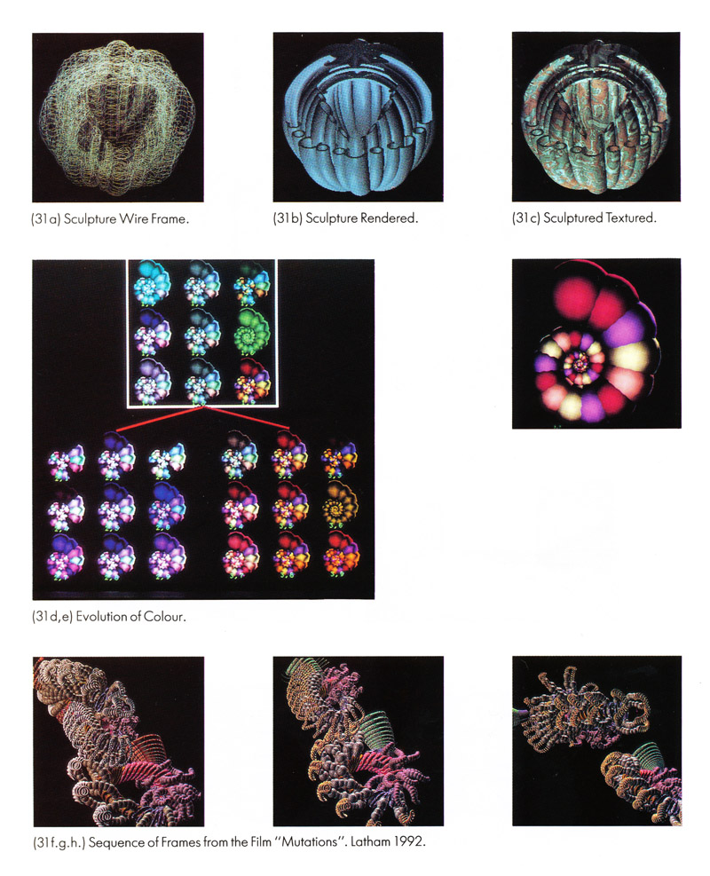
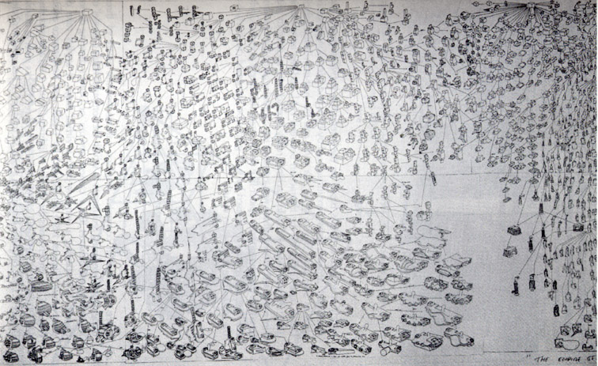
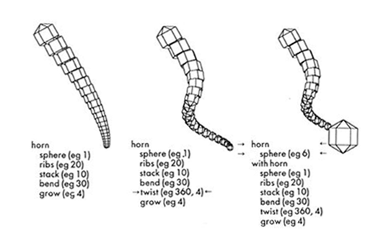
William Latham
Left, top: Form Synth, 1989, detail of a drawing, 10 meter long (Todd/Latham: Evolutionary Art 1992, p.5, fig.1.6).
Left, bottom: Horns, structure mutation with the software Mutator (Todd/Latham: Evolutionary Art 1992, p.99, fig.5.26).
Right: Mutations, film, 1992
(Todd/Latham: Evolutionary Art 1992, unpaginated, fig.31).

Slide 4
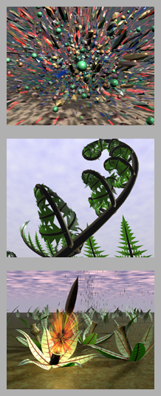
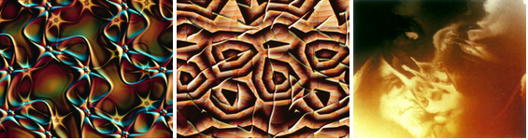
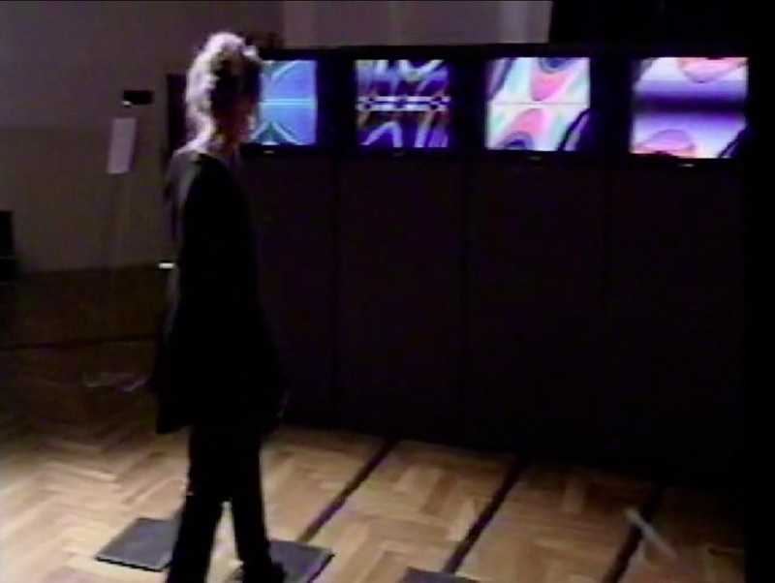
Karl Sims
Top: Primodrial Dance, film, 1991. Image source: URL: http://www.karlsims.com/primordial-dance.html
Left: Sims, Karl: Panspermia, film, 1990.
Image source: URL: http://www.karlsims.com/panspermia.html
Right, bottom: Sims, Karl: Genetic Images", installation, Linz 1993.
Screenshot from URL: http://vimeo.com/7723361.
UR

Slide 5
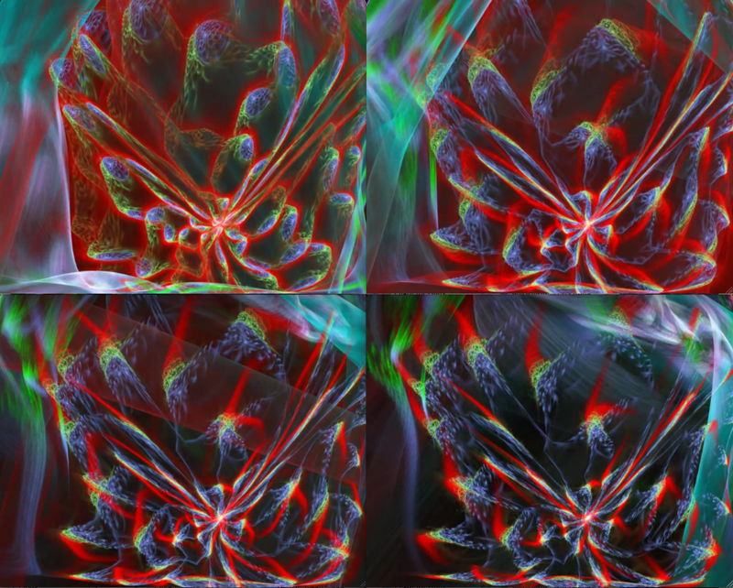
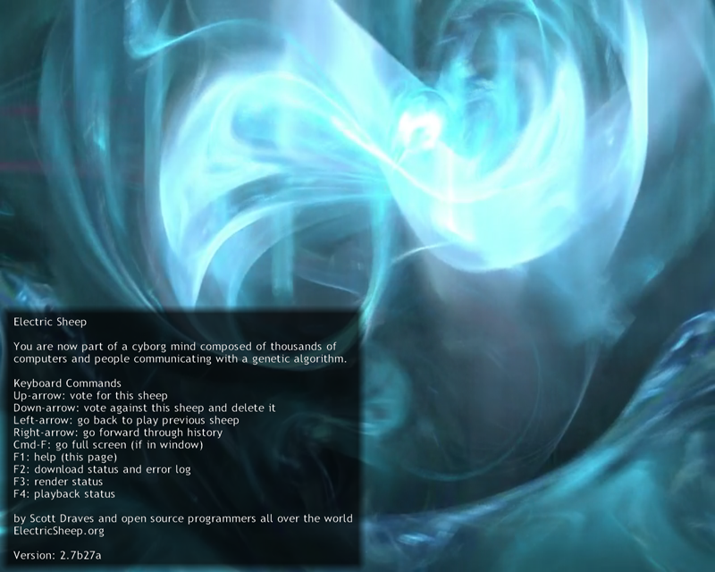
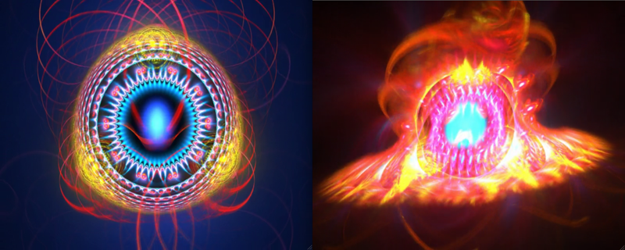
Scott Draves: Electric Sheep, 1999
Internet-connected personal computers, screensaver.
URL: http://www.electricsheep.org/
Right: Screenshots of succesive phases (March-April 2012).
Left: Screenshot (March 2011) with user manual.
UR

Slide 6
Literatur
Bibliography with informations about the abbreviations used in the captions:
Dreher, Thomas: History of Computer Art. Chap. Bibliography. In: URL: http://iasl.uni-muenchen.de/links/GCA-IXe.html
8

