Slide 1
History of Computer Art
URL: http://iasl.uni-muenchen.de/links/GCA_Indexe.html
  Part I: Cybernetics
  Seminar, 28nd April 2014
  Danube University Krems
  Department for Arts and Image Science
  MediaArtHistories: Masters of Art
Thomas Dreher
URL: http://dreher.netzliteratur.net

Slide 2
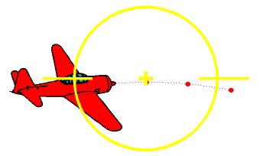
Ballistics WWII
If the target moves across the course of the fighter, a certain amount of lead has to be taken into account: One has to fire at the point in space where the target will be when the projectiles arrive. The fighter therefore has to fly a curve while firing, i.e. it is turning at some rate. Evidently, there would be no problem if the projectiles arrived instantaneously. Of course they do not, but it is advantageous to reduce the time of flight as much as possible, by using guns with a high muzzle velocity.
(Source: Gustin, Emmanuel: The WWII Fighter Gun Debate (1998-99). Chapter Ballistics. In: URL: http://users.telenet.be/Emmanuel.Gustin/fgun/fgun-th.html)
UR

Slide 3
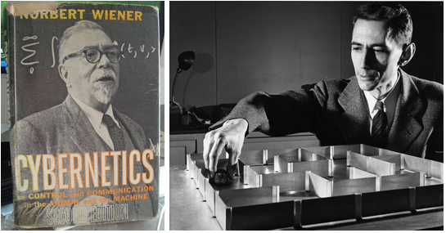
The Founders of Cybernetics
Norbert Wiener (Cover of "Cybernetics", second edition, 1962).
Claude Elwood Shannon with "Theseus" (1952) and the mouse navigating itself through the labyrinth.
(Credit: MIT Museum, Boston / Nixdorf MuseumsForum, Paderborn)
Image source: https://www.flickr.com/photos/arselectronica/5056388921/

Slide 4

Information
The alternative between two values is measured as 1 "bit". The relais of calculating machines and computers switch between the two values "0" and "1". The possibilities to select are calculated as 2_{n}. "n" stands for a number of decisions to choose one of the values "0" and "1". "Probabilities of selection" p₁, p₂…p_{n} belong to any independent, selectable sign. The probability of selection specifies the probability of an element´s occurrence. The probability of selection is multiplied by the logarithm with the base 2 of the probability of selection (p_{n}log₂p_{n}). The products calculated with each probability of selection are added. The sum is negated to obtain the negentropy resp. the information "I”:
(Shannon/Weaver: Theory 1949/1998, p.14,32s.)

Slide 5
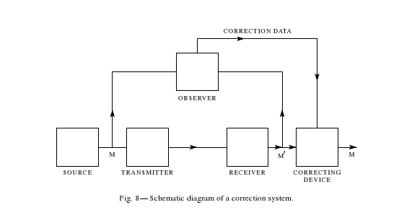
Feedback
Shannon, Claude Elwood: A Mathematical Theory of Communication. In: Bell System Technical Journal, Vol. 27/Nr.3, 1948, p. 409.
UR

Slide 6
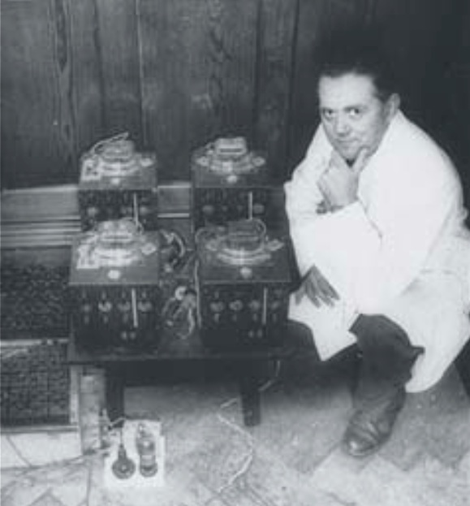
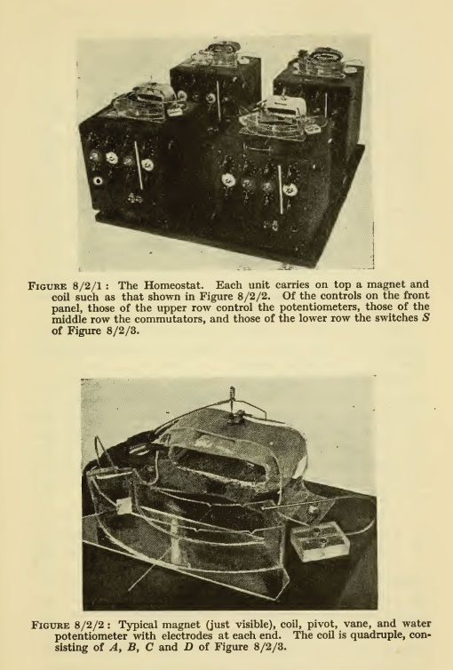
Cybernetic Model: Homeostat
William Ross Ashby beside the "Homeostat", realised in 1946-47.
Image source: URL: http://www.rossashby.info/gallery/images/WRA%20+%20Homeostat.jpg
Ashby, William Ross: Homeostat, 1946-47 (Ashby: Design 1960, p.101).

Slide 7
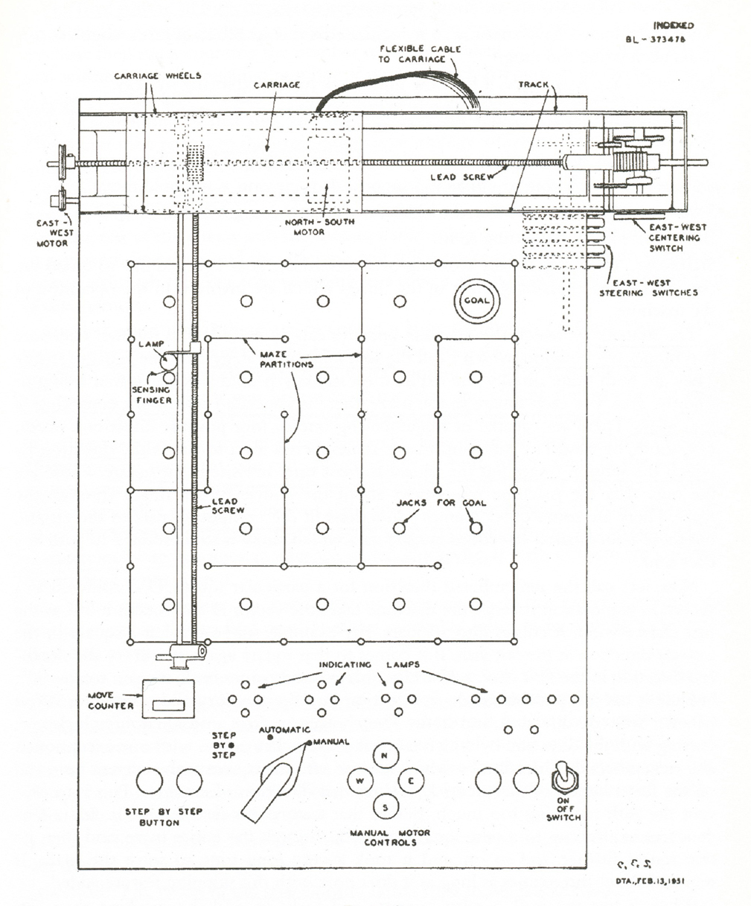
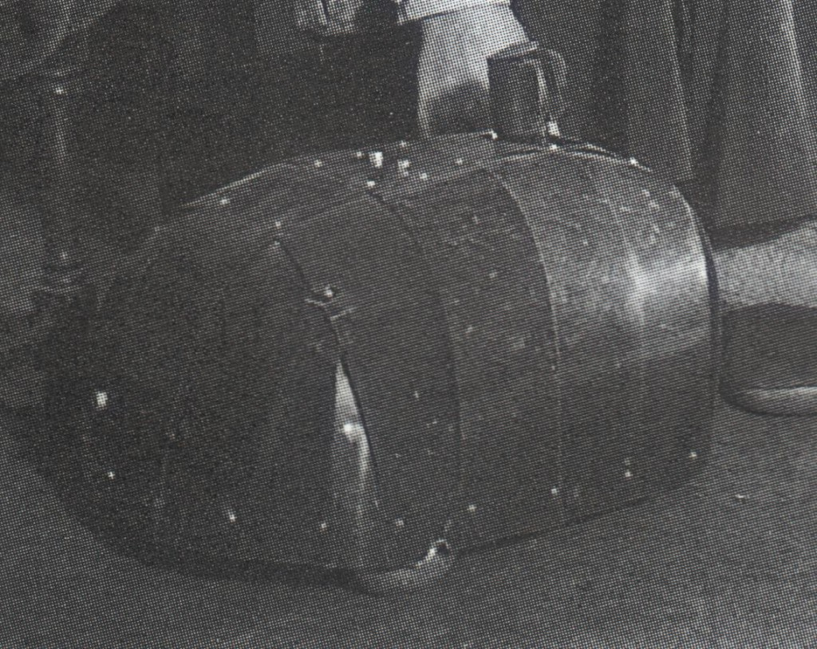
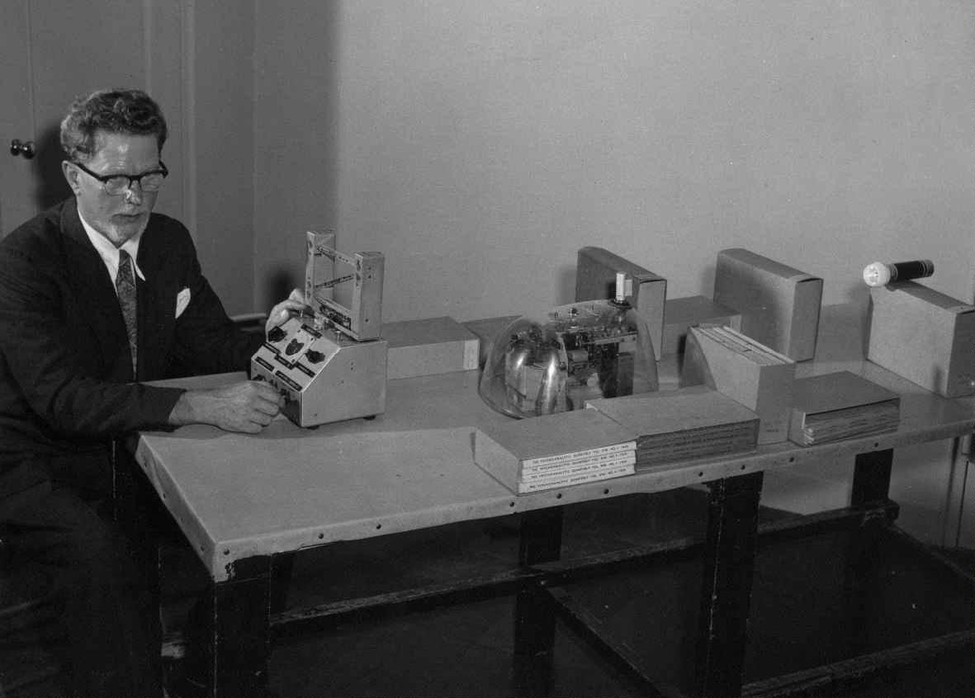
Cybernetic Models
Right: Walter, William Grey: Elmer, 1948.
Image source: URL: http://cyberneticzoo.com/wp-content/uploads/2009/09/ElmerHiRes_p3-1024x813.jpg.
Below: Walter, William Grey: Cora, model for demonstrations on a table, 1951 (constructed by Bunny Warren for the Festival of Britain in London, Exhibition of Science, Science Museum, South Kensington, 1951).
Image source: URL: http://cyberneticzoo.com/wp-content/uploads/WGW-NewYork-p1.JPG
Left: Shannon, Claude Elwood: Maze-Solving Machine, plan (Shannon: Presentation 1951, p.174, figure 8).

Slide 8
Literatur
Bibliography with informations about the abbreviations used in the captions:
Dreher, Thomas: History of Computer Art. Chapter Bibliography. In: URL: http://iasl.uni-muenchen.de/links/GCA-IXe.html
8

